Slide 1

TV tracker
Product Engineering project –Team 2
Brionne Boggioni Lance Boza Jose Rivera

Slide 2
Team Introduction
Lance Boza – Primary Developer
Jose Rivera – Exception/Object Class Developer
Brionne Boggioni – Scrum Leader – Menu Class, SQL Developer

Slide 3
Initial Design
Created ER Schema
Created UML Diagram
This did have to be updated throughout development
Notes:
*We wanted to provide ourselves a strong foundation to build from since we planned to do most of the development Tuesday night.
*The ER schema and UML only changed slightly during development and the time spent in planning and mapping our design was crucial in meeting our time restraint.

Slide 4
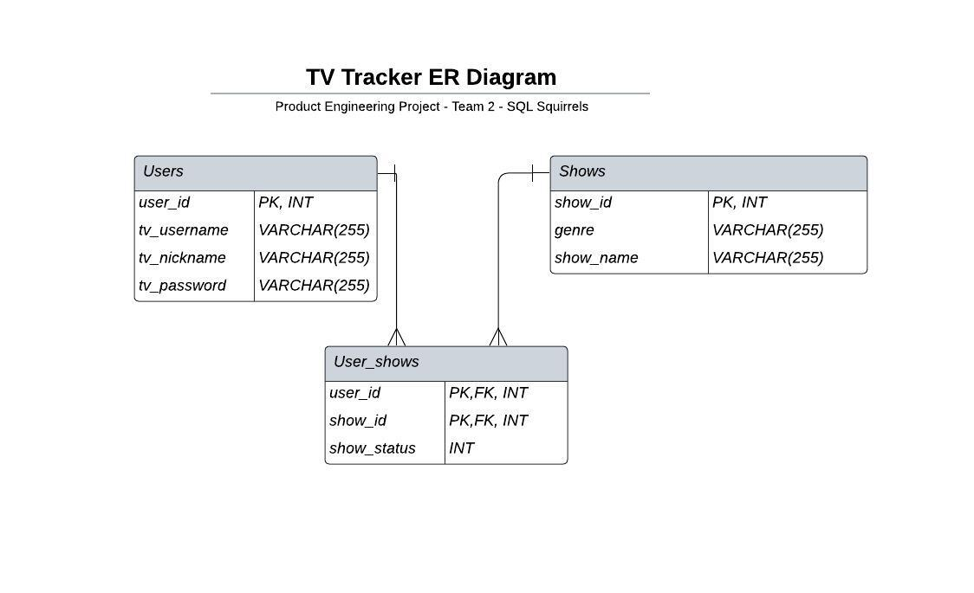
ER Schema
Notes:
Our ER schema was basic but allowed for rapid development of the SQL Script needed.

Slide 5
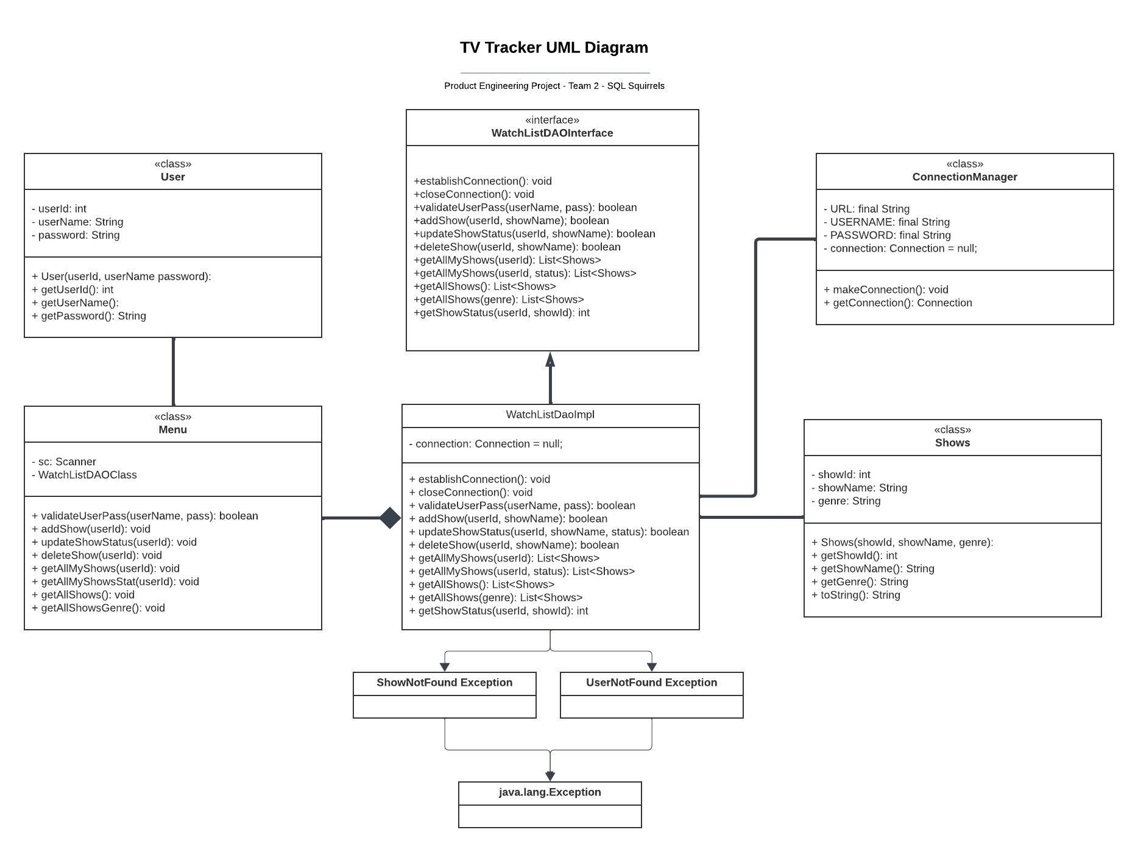
UML Diagram
Notes:
The UML Diagram was more complex, but investing the time here really supported our development
We employed the DAO pattern (Data Access Object) pattern to good effect
Our object classes do not contain any setter methods because our initial development requires direct access to the database to add a user or show.
The Menu class includes our User Validation process, as well as the full menu. This Class handles interaction with the User. The interaction with the Database is handled by the WatchListDaoImpl class.
The connection manager is an independent class at well to allow for local modification without impacting the other classes.

Slide 6
TV Tracker Demo

Slide 7
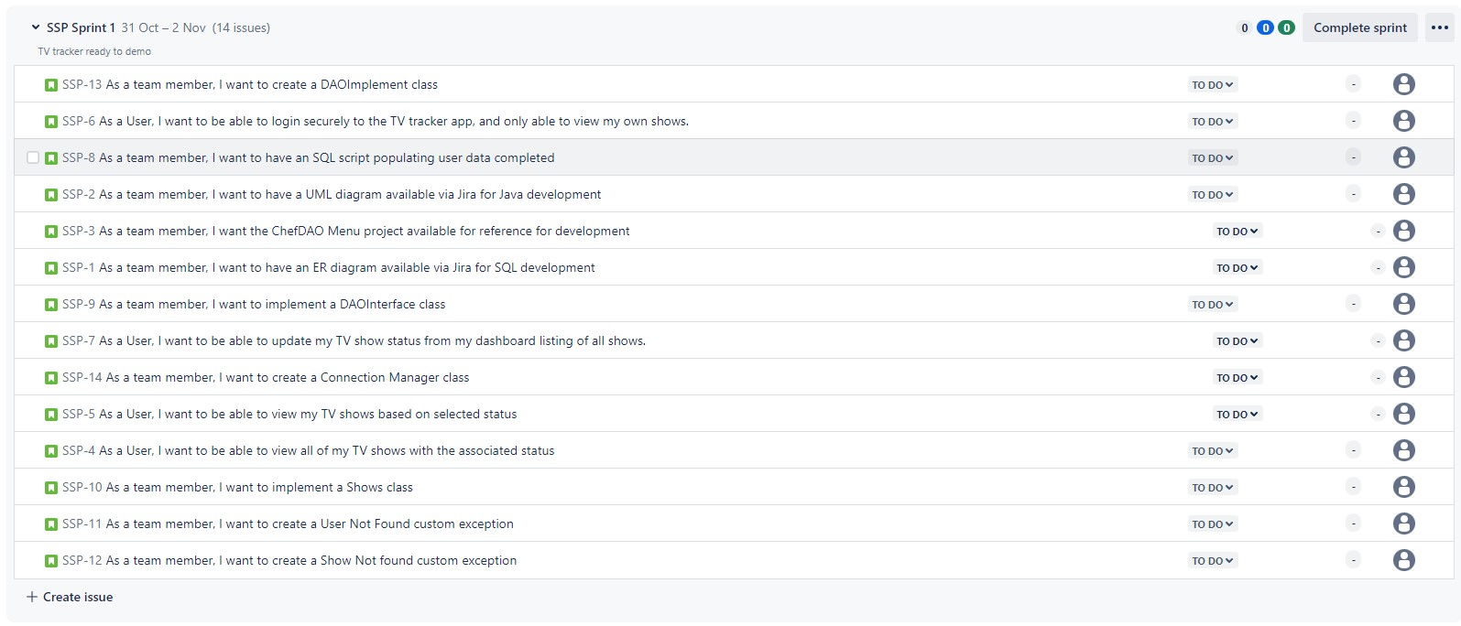
Kanban
Notes:
When creating the Kanban board, we quickly realized the user stories were all being implemented to “provide a good user experience”.
The short timeline for this project and the daily interaction of the team made the Kanban process less useful. For a more extended project we would have had the opportunity to build out the sub-issues and use the embedded features to communicate our progress and design choices to the team.

Slide 8
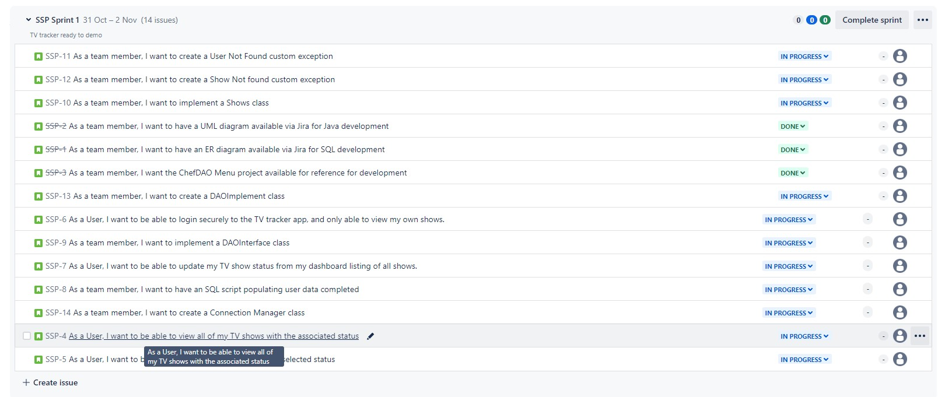
Kanban End of Tuesday
Notes:
By the End of Tuesday we had completed our ER schema and the UML diagram. We divided the initial work, trying to balance overall work.

Slide 9
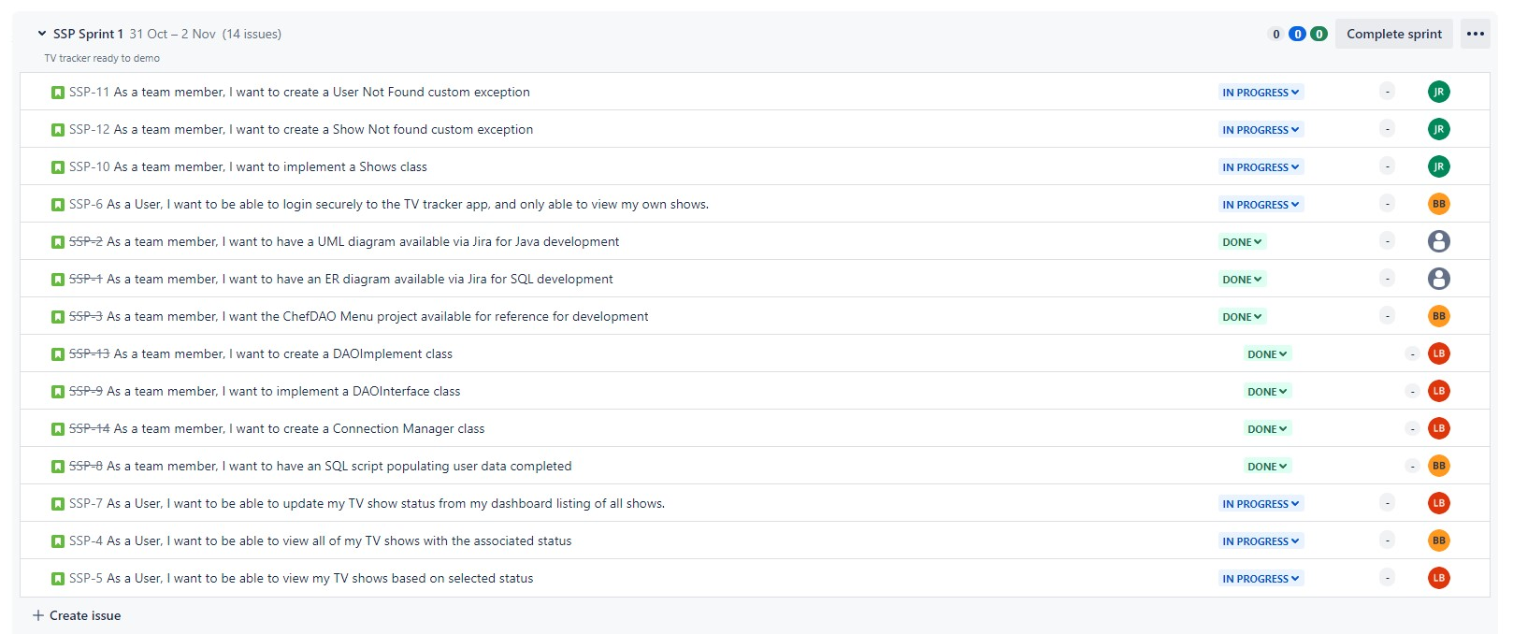
Kanban Wednesday Morning
Notes:
Most of the code was written by Wednesday Morning. We spent the morning finished code and integrating everyone work.
Cue Git/Github debacles.
We were able to finish Wednesday with robust Testing. We opted not to try to add additional functionality and instead focus on a reliable MVP.

Slide 10
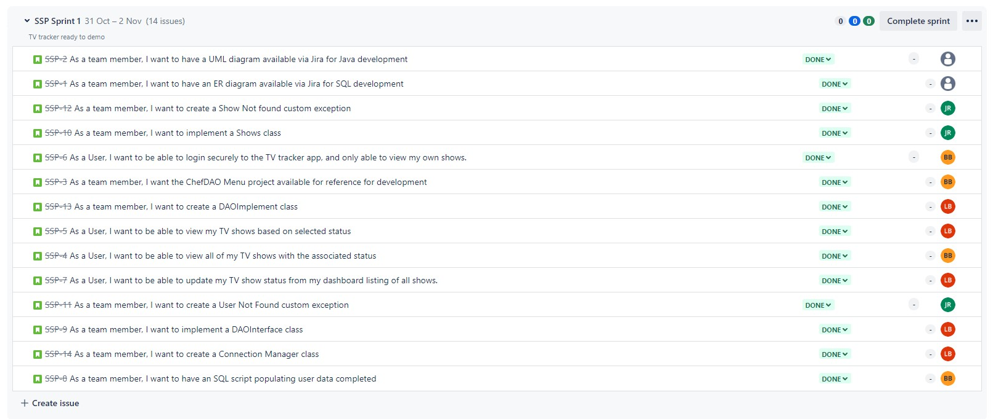
Kanban Wednesday End of Day
Notes:
We were able to finish Wednesday with robust Testing. We opted not to try to add additional functionality and instead focus on a reliable MVP.
We started minimal discussion on what our next Sprint could include.

Slide 11
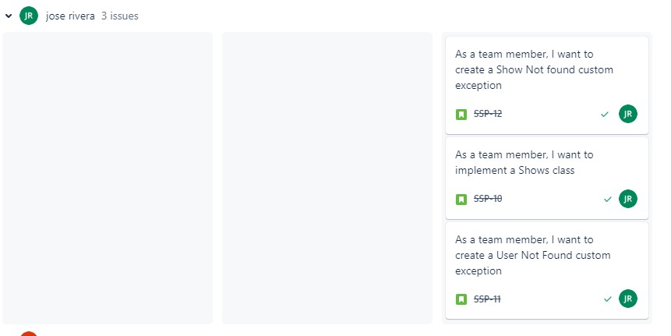
Kanban -Jose
Jose also completed the Main (Runner) class and the Users Class

Slide 12
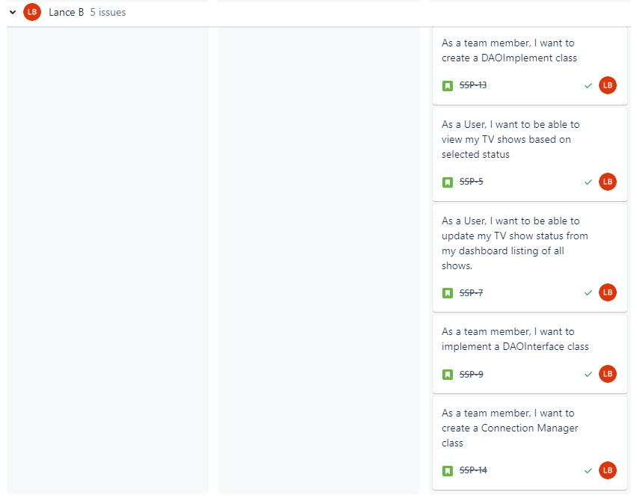
Kanban - Lance

Slide 13
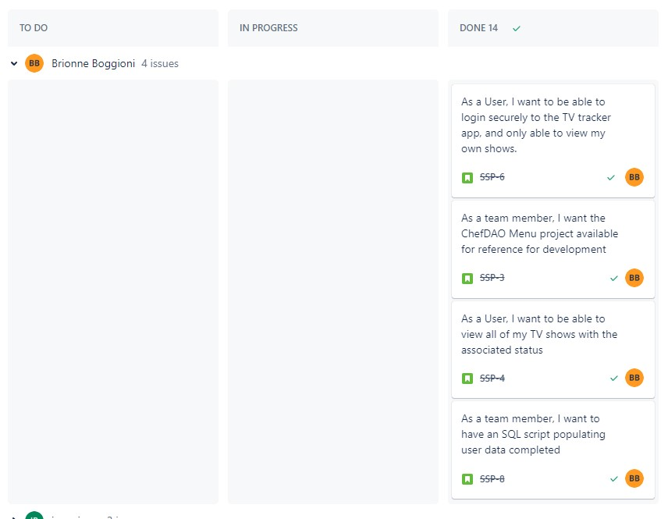
Kanban - Brionne
Notes:
When creating the User Stories, it became clear that the user stories would not necessarily directly relate to individual work assignments.
The user stories related to menu functionality are divided between Lance and I since I was coding the Menu functionality interacting with the user, and Lance was working on the DAO implementation

Slide 14
What did we learn?
Git/Github – duplicate repository issues, nested repository issues.
Input Validation – several iterations trying to account for all possibilities
ER Schema and UML Diagrams are also iterative.

Slide 15
Sprint Review
MVP was achieved within time constraint while maintaining an amicable and collaborative environment.
Congratulations

Slide 16
Sprint Review – Next Steps
Lance – Adding Administration functionality
Jose – Adding Episode/Percentage progress indication
Brionne – Adding Star Rating functionality
Notes:
The extended functionality we would add if we had another Sprint to work on this project.

Slide 17
Adding Star Rating Functionality
Add Options to Menu “To rate one of my shows”, “Read reviews for a Show”
Add fields to user_shows table: “ratings”, “review”
Add the average stars to the All Shows listing
List anonymous reviews with associated star rating under the show title (when the menu option is used).
Notes:
This would allow users to rate the shows they watch and leave reviews.
The ratings and review fields would need to be added to the user_shows
An average stars attribute would need to be added to the Shows object and Shows table.
Add an option to the menu for a user to read reviews associated with a given show. The reviews would be listed without user information associated.

Slide 18
Adding Episodes Tracking Functionality
Add an episodes column to the tv_shows table
Add additional attributes to the Shows Object Class (episodes)
Add Implementation in the WatchListImpl Class
Modify updateStatus method in Menu class to accommodate episode tracking
Notes:
This would

Slide 19
Adding Admin User Functionality
Adding an extra entry and extra field for the tv_users table to account for admins
Add Implementation in the WatchListImpl Class
Prompt anyone who is an Admin a separate Menu to give them admin functions

